Slide 1
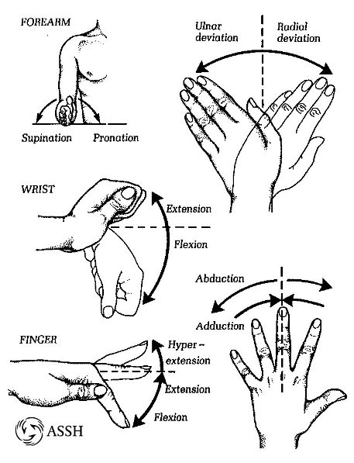
Technical Analysis
Real hand motion
3 degrees of freedom
Supination/pronation
Extension/flexion
Ulnar deviation/radial deviation

Slide 2
Technical Analysis
2 degrees of freedom
Twist and extension/flexion

Slide 3
Engineering Design
Motors for fingers
A digital I/O for signals from sensors and motors
Granular jamming pad for firm grip

Slide 4
Engineering Design
Data when moving fingers
Signals when moving wrist
Signals when grabbing objects

